Slide 1
Efficient Load Value Prediction using Multiple Predictors and Filters
Rami Sheikh, and Derek Hower

Slide 2
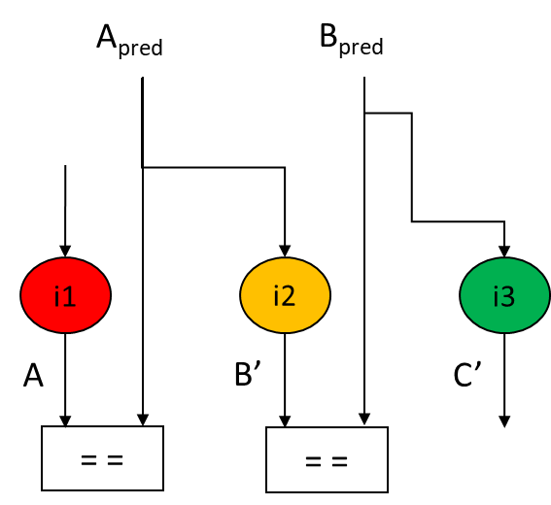
Executive Summary of Efficient Load Value Prediction
Value prediction breaks true data dependency
State-of-art VP schemes don’t scale well
Low ROI
w/ VP
Baseline (No VP)
Increase Budget
IPC = 1
IPC >> 1
All Load Insts
VP #1
VP #3
VP #2
Huge Budget
Significant Overlap
No single VP scheme is capable of predicting all loads efficiently
Under-utilized Design
Notes:
Under-utilized Design → Not all VPs are needed in all apps
Reality: no single predictor is capable of capturing most loads, not efficiently at least
Multi-pred has lots of overlap

Slide 3
Executive Summary of Efficient Load Value Prediction
Our proposal: a complementary, multi-predictor design
Eliminate unnecessary overlap
Improve utilization and storage allocation
Mitigate pathological behavior
Industry evaluation framework
Results
Significant performance improvements
Outperform EVES Predictor (winner of CVP-1)
Smart Training
Hetero. Pred
Predictor Fusion
Accuracy Monitors
Multi-Pred
S: 54%-74%
Compared to EVES VP: 2X Coverage 50% Higher Speedup
Best Single Predictor
Session 6A: INDUSTRY SESSION 2, MICROARCHITECTURE @ 2PM
Notes:
Our proposal: a complementary, multi-predictor design + Mitigate pathological behavior using Accuracy Monitors + Eliminate unnecessary overlap with Smart Training + Improve resource allocation using Predictor Fusion + Optimize storage allocation using Heterogenous pred.

Slide 4
Agenda
Motivation
Methodology
Microarchitecture
Evaluation
Conclusion
Notes:
benchmark suites: SPEC2K [38], SPEC2K6 [39], and EEMBC [30].
Moreover, we enriched our benchmark pool with other popular applications:
Linpack [19], media player [23], browser benchmark [4],
and various Javascript benchmarks

Slide 5
Motivation and Methodology
5

Slide 6
Motivation
ILP is inherently limited by true data dependencies
➔ Value Prediction
Remarkable progress towards practical implementation of Value prediction over the past three decades
Unfortunately, few challenges still need to be addressed …
Costly Mispredictions
→ High Accuracy (>99%)
→ Low Coverage
➔ Scale up predictor resources
→ Predictors scale poorly beyond some point
→ Some predictors are more suitable for predicting certain load patterns
➔ Use a multi-predictor design
→ Which predictors to use?
→ Challenges: budget, utilization, pathological cases ..etc.
Notes:
Our analysis of state-of-art VPs, found that no one predictor is capable of prediction all loads, at least not efficiently

Slide 7
Methodology
Analyzed loads in 85 workloads
Pattern-1: Suitable for Last Value Prediction
Pattern-2: Suitable for Stride Address Prediction
Pattern-3: Suitable for Context-based Prediction
Notes:
benchmark suites: SPEC2K [38], SPEC2K6 [39], and EEMBC [30].
Moreover, we enriched our benchmark pool with other popular applications:
Linpack [19], media player [23], browser benchmark [4],
and various Javascript benchmarks

Slide 8
Microarchitecture
8

Slide 9
Value Prediction
Direct
Indirect
Last VP
Stride AP
Context VP
Context AP
Two approaches to load value prediction
Direct: predict the value
Indirect: predict the address, and read the value from data cache
Context Unaware
Context Aware
VTAGE
DLVP
❻
Update Predictor(s), and Flush on Value Misprediction
Fetch (multi-cycle)
Decode (multi-cycle)
Rename
Register File Access
Allocate
Issue
Execute
Commit
❹
On a hit, return predicted value
Data Cache
❺
Value Prediction Engine (VPE)
(Optional) On a miss, generate a prefetch
Address Prediction
If hit and confident
addr
On pipe bubbles
❷
Predicted Address Queue (PAQ)
❸
Fetch Group Address (a proxy for load PC)
❶
Filtering Mechanism
Value Prediction
If hit and confident
value
Preference: direct over indirect
CVP > LVP > CAP > SAP
Components needed by any value prediction scheme
Components specific to Value Prediction
context-aware over context-unaware
Components specific to Value Prediction via Address Prediction
Notes:
We prefer:
Direct predictors because they do not require a data cache access, and are not susceptible to cache misses, cache bandwidth constraints, and the increased power of a cache access.
Context-unaware predictors because they are more storage-efficient

Slide 10
Evaluation Framework
10

Slide 11
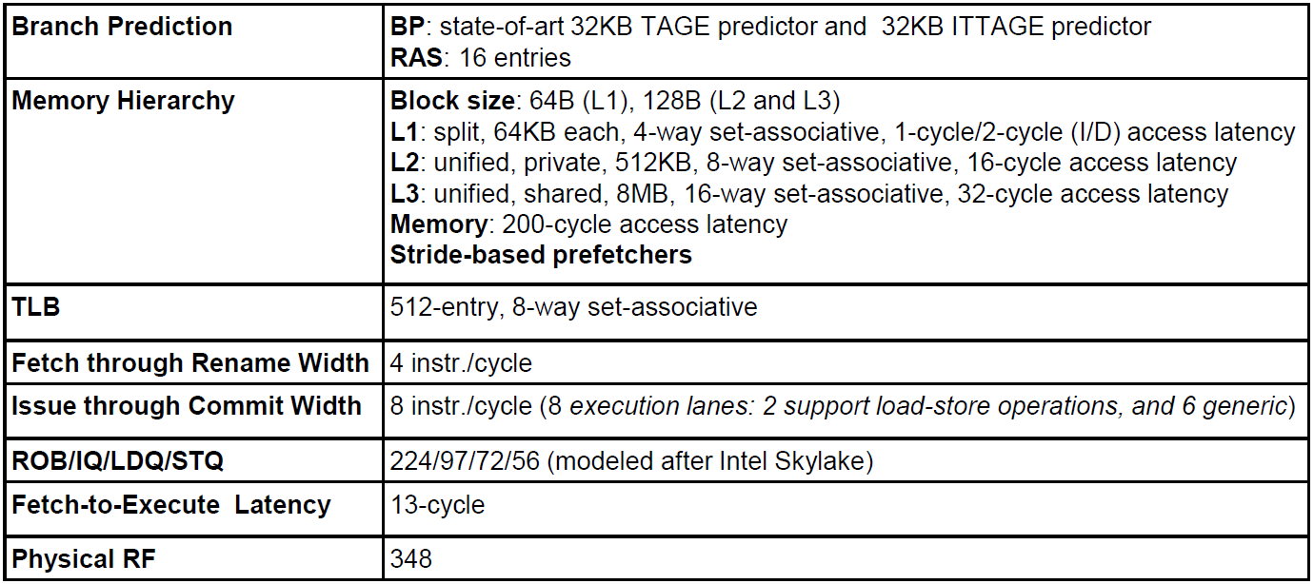
Evaluation Environment
Performance model
In-house cycle-accurate, RTL-validated, industry simulator
Baseline structures are configured as close as possible to Intel’s Skylake core
State-of-art TAGE and ITTAGE branch predictors
Memory dependence predictor similar to Alpha 21264
All of the VPs used are tuned to reach 99% accuracy (see paper for details)
Notes:
benchmark suites: SPEC2K [38], SPEC2K6 [39], and EEMBC [30].
Moreover, we enriched our benchmark pool with other popular applications:
Linpack [19], media player [23], browser benchmark [4],
and various Javascript benchmarks

Slide 12
Results
12

Slide 13
Performance: Single (Component) vs. Multi-predictor (Composite)
Composite design trains all predictors
16%
32%
19%
Notes:
Preference: LVP > CVP > SAP > CAP

Slide 14
Observation #1: Pathological Behavior
SAP establishes confidence after observing the same delta 9 times
It takes: 2 iterations to detect stride, and 9 more iterations to get confident
SAP mispredicts 100% of the time!
Solution: Accuracy Monitors (AM)
Track prediction accuracy, and
squash prediction if AM indicates prediction unreliable

Slide 15
Optimization #1: Accuracy Monitors (AM)
Two types of Accuracy Monitors (AM)
Coarse-grain, epoch based:
Track number of correct and incorrect confident predictions per predictor ➔ 8 counters total
At end of each epoch:
For each predictor, compute Mispredictions-per-kilo-prediction (MPKP)
If MPKP > threshold ➔ predictor goes into training mode (i.e., predictions are not used)
Counters are reset
Fine-grain, PC based:
Use a small, direct mapped, pc indexed/tagged table, with eight counters per entry
At prediction time:
On a hit in the table, compute MPKP for each predictor
If MPKP > threshold ➔ squash the prediction
Allocation happens on a value misprediction

Slide 16
Observation #2: Overlap Among Predictors
Breakdown of Predicted Loads
66% by 2+ Predictors
13% by 2+ Predictors
Predictors Trained Per Load = 4
Predictors Trained Per Load = 1.1
Solution: Smart Training (ST)
If no prediction is made, train all predictors
If a predictor mispredicted, train it
Prefers value over address and context-unaware over context-aware: LVP > CVP > SAP > CAP
Special case: If SAP produced a correct prediction but was not chosen for training, we invalidate the SAP entry
Notes:
If no prediction is made, train all predictors are trained to minimize the amount of time to get a confident prediction. If one or more predictions are made, we only train the predictors that (a) mispredicted, or (b) have the lowest cost according
the heuristic listed below. By always training a component that produced an incorrect prediction, we encourage a quick
eviction of the associated entry (a trained misprediction resets confidence).
Among predictors that produce a correct prediction, we train them in the following order that prefers value over address and context-agnostic over context-aware:
LVP, CVP, SAP, CAP. Additionally, whenever SAP produced
a correct prediction but was not chosen for training, we
invalidate the SAP entry.

Slide 17
Optimization #2: Smart Training (ST)
Possible Solution: Smart Training Algorithm
If no prediction is made, train all predictors
Else if a predictor mispredicted, train it
Else, prefers value over address and context-agnostic over context-aware: LVP > CVP > SAP > CAP
If SAP produced a correct prediction but was not chosen for training, we invalidate the SAP entry
Notes:
If no prediction is made, train all predictors are trained to minimize the amount of time to get a confident prediction. If one or more predictions are made, we only train the predictors that (a) mispredicted, or (b) have the lowest cost according
the heuristic listed below. By always training a component that produced an incorrect prediction, we encourage a quick
eviction of the associated entry (a trained misprediction resets confidence).
Among predictors that produce a correct prediction, we train them in the following order that prefers value over address and context-agnostic over context-aware:
LVP, CVP, SAP, CAP. Additionally, whenever SAP produced
a correct prediction but was not chosen for training, we
invalidate the SAP entry.

Slide 18
Observation #3: Under-utilization
Predictor Fusion + Heterogenous Predictors
Solutions
Proposed Solutions:
Predictor Fusion: identify under delivering predictors and re-purpose them
Heterogenous Predictors
See paper for more details
Notes:
Simplification assumptions: - all VPs has same # of bits/entry
- VPs have same # of entries

Slide 19
Putting All Pieces Together
Notes:
Simplification assumptions: - all VPs has same # of bits/entry
- VPs have same # of entries

Slide 20
Comparison Against EVES Predictor (CVP-1 Winner)
EVES: 1st Value Prediction Champion
Enhanced Vtage Enhanced Stride
Composite outperforms EVES in 67 out of 85 workloads, while EVES outperforms in 9 workloads only
> 2X Coverage > 50% Higher Speedup
Notes:
The composite predictor outperforms
EVES in 67 out of 85 workloads, while the latter
outperforms the composite predictor in 9 workloads only

Slide 21
Conclusions
We advocated a composite predictor design
Consists of two address and two value predictors
We proposed several optimizations:
Accuracy Monitors:
Mitigate pathological behavior
Smart Training:
Eliminate unnecessary overlap
Predictor Fusion:
Improve utilization
Results
Significant performance improvements
Outperforms the best component predictor by 54%-74% depending on predictor size
Outperform EVES Predictor (winner of CVP-1)
> 2X Coverage, and > 50% Higher Speedup

Slide 22
Thank you! Questions?
22

Slide 23
Backup
23

