Slide 1
PageSeer: Using Page Walks to Trigger Page Swaps in Hybrid Memory Systems
Apostolos Kokolis, Dimitrios Skarlatos and Josep Torrellas
University of Illinois at Urbana-Champaign
http://iacoma.cs.uiuc.edu

Slide 2
Introduction
Data intensive applications demand memory capacity
DRAM can no longer provide the capacity needed
Non-volatile memory (NVM) technologies
+ higher density
- slower
Solution: Hybrid Memory Systems
Cannot replace DRAM entirely
MC
DRAM
NVM

Slide 3
Managing a Hybrid Memory System
DRAM is a cache for the NVM
DRAM and NVM share a flat address space
MC
Capacity loss
DRAM
More capacity & BW
NVM
Need to swap memory
between NVM and DRAM

Slide 4
Challenges of HW Managed Hybrid Schemes
Memory Request for Page D
HW needs to
Swap pages
Decide which pages to swap
Track page activity
Accurately identify “hot” pages to swap
Record the page remappings
MC
D | 3
DRAM
NVM
A
B
C
D
F

Slide 5
Challenges of HW Managed Hybrid Schemes
Memory Request for Page C
HW needs to
Swap pages
Decide which pages to swap
Track page activity
Accurately identify “hot” pages to swap
Record the page remappings
MC
A | C
DRAM
NVM
C
B
A
D
F

Slide 6
Challenges of HW Managed Hybrid Schemes
HW needs to
Swap pages
Decide which pages to swap
Track page activity
Accurately identify “hot” pages to swap
Record the page remappings
Store meta-data information
Remappings
Page activity
MC
DRAM
NVM
C
B
A
D
F

Slide 7
Prior Work
Focused on identifying “hot” pages to swap:
Use access counters per memory segment
Conservative swapping → Miss opportunities
Start a swap on a first access to a memory segment
Aggressive swapping → Unnecessary traffic
Predict future memory accesses
Hard to predict
NVM
DRAM
Segment ID | Counter
A | 5
B | 4
C | 2
≥ Threshold
Read
Swap Buffer
Write
Write
Read
Swap Buffer

Slide 8
PageSeer Motivation
Swapping is a costly operation and takes time
Need accuracy in predicting future memory accesses and swapping
Need to start the swaps as early as possible
How to predict future memory accesses?
NVM
DRAM
Read
Swap Buffer
Write
Write
Read
Swap Buffer

Slide 9
PageSeer Motivation
TLBs for fast translations
VA to PA address mappings => OS page tables
Memory requests require two steps
Translation from VA to PA
Data access
CPU
Request
Fill
Caches
Fill
TLB
TLB
PW
PTE
L2
LLC
Memory
Translation Timeline
Replay CPU
Request
TLB
L1
L2
LLC
Memory
Data Access Timeline

Slide 10
PageSeer Motivation
Memory intensive applications cause TLB misses
TLB miss results in a page walk
If the page is cold
Page translation
Actual page data
Miss in caches
CPU
Request
Page
Walk (PW)
Fill
Caches
Fill
TLB
TLB
L2
LLC
Memory
Translation Timeline
Replay
Request
TLB
L1
L2
LLC
Memory
Data Access Timeline

Slide 11
PageSeer Motivation
Insight: Page Walks give information
about future accesses to a page earlier
At this point we know the page that will be accessed
CPU
Request
Page
Walk (PW)
Fill
Caches
Fill
TLB
TLB
L2
LLC
Memory
Translation Timeline
Replay
Request
TLB
L1
L2
LLC
Memory
Data Access Timeline

Slide 12
Contribution: PageSeer
Uses pages walks to trigger page swaps in HW-only hybrid memory systems
Uses a page-correlation mechanism to prefetch page swaps
Includes HW structures to recognize and move “hot” pages to DRAM
Improves performance by 19% and reduces Average Main Memory Access Time (AMMAT) by 29% over state-of-the-art

Slide 13
Background – Page Walk
47 - 39 | 38 - 30 | 29 - 21 | 20 - 12 | 11 - 0
Virtual Address
c
PTE A
+
4-KB Page A
c
Physical Address
c
PMD A
+
+
c
PUD A
+
c
PGD A
+
CR3

Slide 14
PageSeer Design
Processor Chip
Communication link between the MMU and the Hybrid Memory Controller
When a Page Walk reaches the PTE level
Conventional: MMU sends a memory request to the caches
PageSeer: in addition MMU sends it to the HMC
Inform the HMC about forthcoming memory accesses
Core
Core
L1
L1 TLB
L1
L1 TLB
L2
L2 TLB
L2
L2 TLB
MMU
MMU
Shared L3
Hybrid Memory Controller (HMC)
Path to Memories
Crossbar interconnect
Logic Layer
Logic Layer
DRAM
NVM

Slide 15
PageSeer Overview
L2
TLB
DRAM
Goal: give time to the HMC for swaps and to prepare its HW structs
MMU
NVM
Shared L3
HMC
Translation Timeline
Data Access Timeline

Slide 16
PageSeer Overview
L2
TLB
DRAM
MMU signals the HMC
HMC finds physical page number
HMC prepares its HW structures
Starts swapping
2
A
PTE
3
MMU
1
NVM
4
Shared L3
C
HMC
CPU
Request
TLB
PW
PTE
L2
LLC
HMC
Memory
Fill
Caches
Fill
TLB
Translation Timeline
Replay
Request
TLB
L1
L2
LLC
HMC
Memory
Data Access Timeline

Slide 17
PageSeer Overview
L2
TLB
DRAM
MMU signals the HMC
HMC finds physical page number
HMC prepares its HW structures
Starts swapping
2
C
PTE
3
MMU
1
NVM
4
Shared L3
A
HMC
CPU
Request
TLB
PW
PTE
L2
LLC
HMC
Memory
Fill
Caches
Fill
TLB
Benefits:
If the MMU request reaches HMC → PTE is already prefetched
When the request is replayed → page swap to DRAM has already started
Translation Timeline
Replay
Request
TLB
L1
L2
LLC
HMC
Memory
Data Access Timeline

Slide 18
Hybrid Memory Controller
Hybrid Memory Controller (HMC)
Page Remapping Table (PRT)
Records remappings between DRAM-NVM pages
On the critical path
Every memory request checks the PRT
MMU signal
Memory request
PRT
Path to Memories

Slide 19
Hybrid Memory Controller
Hybrid Memory Controller (HMC)
Page Remapping Table (PRT)
Hit rate and lookup time is important => Cache some entries
Swap at page granularity
MMU signal
Memory request
PRT
NVM Pages
DRAM Pages
NVM PPN
DRAM PPN
NVM PPN
DRAM PPN
Set 0
Set 1
Set 2
Set 3
Path to Memories

Slide 20
Hybrid Memory Controller
Hybrid Memory Controller (HMC)
Hot Page Tables (HPTs)
1 for DRAM – 1 for NVM
Track hot pages
DRAM HPT
Pages that should remain in DRAM
NVM HPT
Candidate pages to swap to DRAM
MMU signal
Memory request
PRT
HPTs
Page Number | Counter
Path to Memories

Slide 21
Hybrid Memory Controller
Hybrid Memory Controller (HMC)
Page Correlation Table (PCT)
Keeps historic data for page accesses
Captures the correlation between pages → prefetch
MMU signal
Memory request
PRT
PCT
HPTs
PCT entry
PPN | Counter | Next PPN | Next counter
Path to Memories

Slide 22
Hybrid Memory Controller
Hybrid Memory Controller (HMC)
MMU Driver
Receives the MMU signal and checks for prefetch swaps
Receives requests for PTEs
Caches recently fetched PTEs
MMU signal
Memory request
PRT
PCT
HPTs
MMU Driver
Path to Memories

Slide 23
Hybrid Memory Controller
Hybrid Memory Controller (HMC)
Swap Driver
Initiates page swaps triggered from
NVM HPT
PCT
Checks if an access is for a page that is being swapped
MMU signal
Memory request
PRT
PCT
HPTs
MMU Driver
Swap Driver
Path to Memories

Slide 24
Evaluation Methodology
Simulator
Simics + SST + DRAMSim2
Modified DRAMSim2 for NVM
Architectures Compared
MemPod [Prodromou ’18]
Workloads
20 benchmarks (SPEC CPU2006, Splash-3 and CORAL)+ 6 mixes of the benchmarks
PoM [Sim ’14]
PageSeer

Slide 25
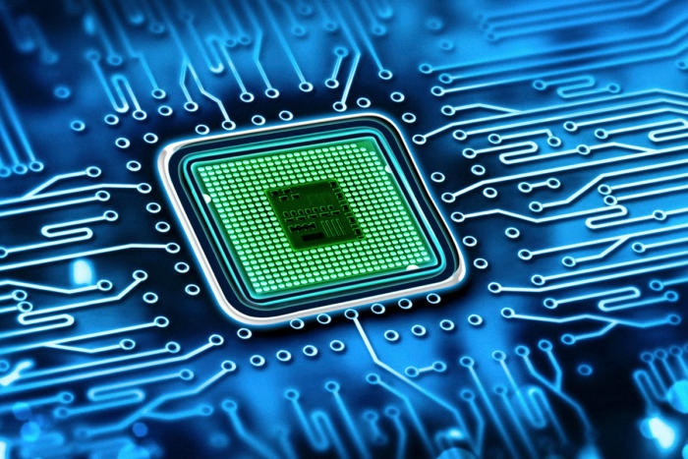
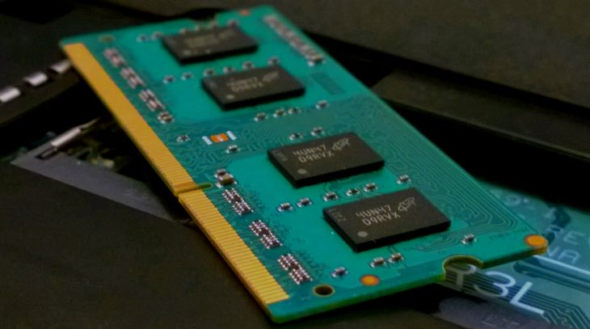
Evaluation Parameters
Processor
4 cores @ 2GHz
Memory
1 GHz DDR
HMC
Swap granularity 4KB
DRAM: 512MB, 4 channels
NVM: 4GB, 2 channels
8MB shared L3
PRT and PCT: 32KB, 4-way set associative

Slide 26
Main Memory Accesses
2%
33%
40%
9%
PageSeer redirects 33% more
memory requests to DRAM
It services read requests from swap
buffers during swaps

Slide 27
Swap Effectiveness
Positive
Access DRAM thanks to a swap
12%
10%
1%
15%
5%
Negative
PageSeer achieves 12%-15% more
positive memory accesses because of
swaps and only 1% negative accesses
Access NVM due to a swap
Neutral
Access DRAM or NVM as if no swap happened

Slide 28
Types of swaps
Prefetching-Triggered: Aggressive swaps triggered by the Page Correlation Table based on historic access patterns
MMU-Triggered: Subset of Prefetching Triggered directly initiated by the MMU
HPT-Triggered: Conservative swaps triggered by the NVM Hot Page Table when accesses to a page reach a threshold

Slide 29
Swap Characterization
37%
Most of the swaps are Prefetching swaps
Most Prefetching swaps are MMU swaps
63%
49%

Slide 30
Swap Characterization

Slide 31
Swap Characterization
In every case PageSeer maintains
high performance

Slide 32
Performance Speedup
28%
19%
Reduces AMMAT by 37% and 29%
Improvement is mainly due to:
Swaps
Less time spent at the PRT (~62% less)

Slide 33
Also in the paper . . .
More details on PageSeer
Operation
Power and area numbers for the HMC hardware structures
Swap accuracy, page walk requests and swap characterization
How to utilize the swap buffers during the swap process

Slide 34
Conclusion
PageSeer uses page walks and correlation prefetching to trigger page swaps accurately and promptly
MMU hints help to identify future memory accesses; start swaps and prepare the HMC hardware structures
PageSeer improves IPC by 19% and reduces AMMAT by 29% over prior state-of-the-art schemes

Slide 35
PageSeer: Using Page Walks to Trigger Page Swaps in Hybrid Memory Systems
Apostolos Kokolis, Dimitrios Skarlatos and Josep Torrellas
University of Illinois at Urbana-Champaign
http://iacoma.cs.uiuc.edu
Thank you!!
HPCA 2019
Session 8A: MEMORY

Slide 36
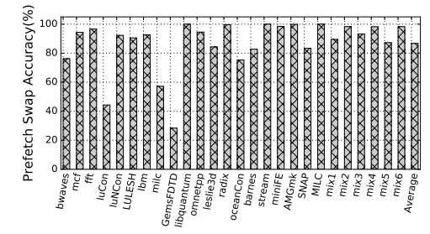
BACKUP SLIDES
Average: 87% accuracy

Slide 37
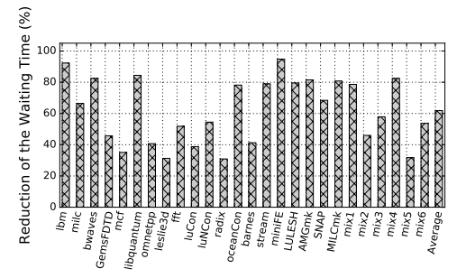
BACKUP SLIDES
Average: 62% PRT reduction

Slide 38
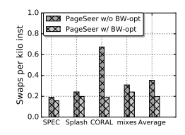
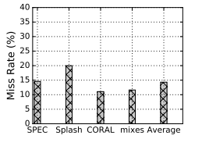
BACKUP SLIDES
0.35 to 0.19 swaps per KInst
15% PTE cache misses

Slide 39
END

